Slide 1

Estimating Remaining Useful Life (RUL) from Vibration Sensor Data
calgaryanalyticsltd.com

Slide 2
Degradation Modeling vs Life Data Analysis
Most failures are preceded by an underlying degradation process.
Measurement of this degradation signal over time can have useful advantages over life data analysis
Life Data analysis involves measuring time to failure and time to censoring.
Degradation measurements involve additional measurements over time before the unit experiences failure.
Additional measurements mean additional reliability information that can be used for equipment prognostics and maintenance management.
calgaryanalyticsltd.com

Slide 3
Degradation Modeling
By measuring the degradation signal, we are able to monitor the current condition of an equipment as well as make predictions on remaining life.
Such predictions can be updated as additional degradation measurements become available over time.
Real world impacts of degradation modeling:
avoid costly and catastrophic failures and unplanned shutdowns.
enable proactive maintenance and optimize spare parts management.
calgaryanalyticsltd.com

Slide 4
Example: Wind Turbine High Speed Bearing Vibration
Saidi, Lotfi, et al. [1] analyzed vibration signals from a wind turbine bearing to estimate the remaining useful life (RUL) using Support Vector Regression (SVR).
A tutorial on the MATLAB website [2] uses the same vibration data to create a “health indicator” and estimate RUL with an exponential degradation model using its inbuilt functions.
The vibration data is available on GitHub. I replicated the same analysis (with a few minor changes), but using the R open source statistical software. This document is a summary of the analysis and the results.
calgaryanalyticsltd.com

Slide 5
Repeat after signal acquisition the next day
Predict
Predict Remaining Useful Life (RUL) based on the estimated parameters
Collect
Vibration signal of 6 seconds was collected every day
04
01
03
Transform
Transform data from the vibration signal from time-domain to frequency-domain using Short Time Fourier Transform (STFT)
Estimate
Fit an exponential degradation model and estimate model parameters
02
calgaryanalyticsltd.com

Slide 6
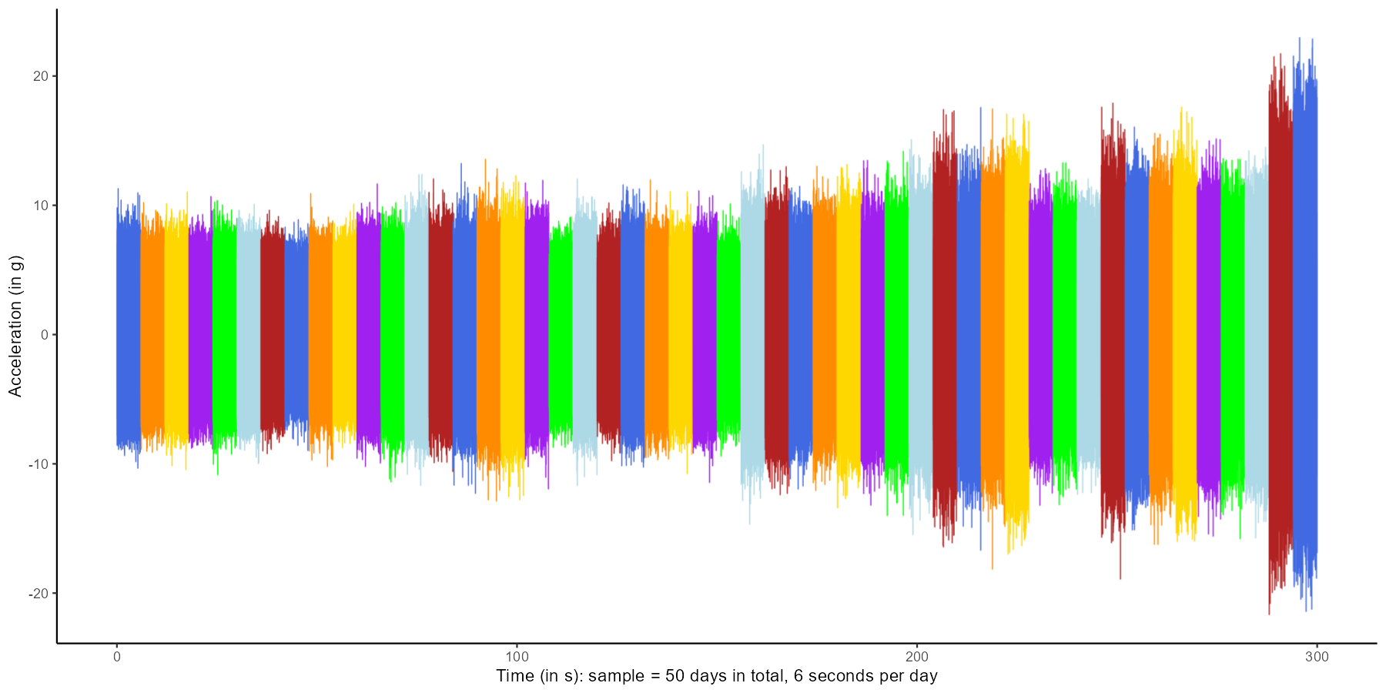
Collect
50 days of vibration data, collected over 6 seconds every day
Notice the degrading trend
calgaryanalyticsltd.com

Slide 7
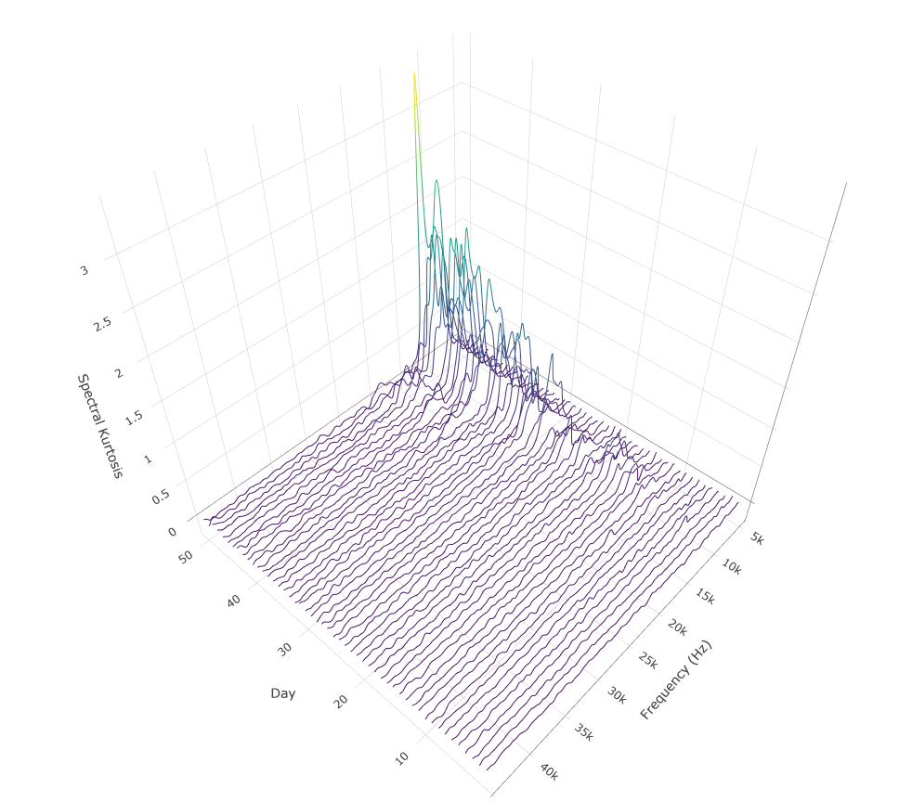
Transform
Use Short Time Fourier Transform to convert information from time domain to frequency domain and then calculate the spectral kurtosis.
Notice the increasing trend in spectral kurtosis around the fault frequency of ~ 10,000 Hz, making it a good candidate for the degradation signal.
Side note: Choosing the window size for Short Time Fourier Transform is a crucial step, and is discussed in Appendix A
calgaryanalyticsltd.com

Slide 8
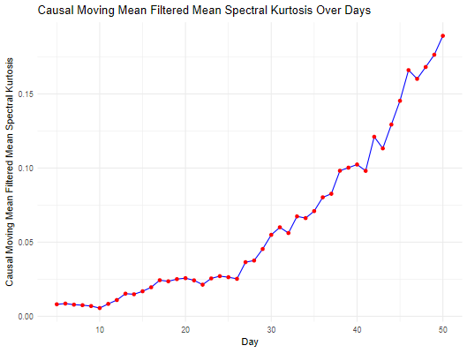
Estimate
Fit an exponential degradation model to the causal moving mean spectral kurtosis
Side note: Causal moving mean averaging applied, where the value at a point is the average value from the past 5 days.
calgaryanalyticsltd.com

Slide 9
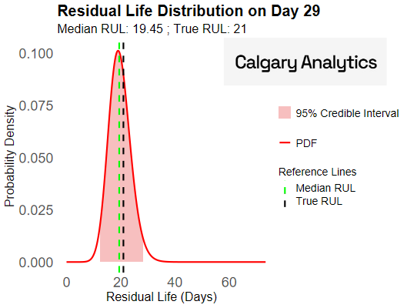
Predict
Click here to see an animation of the evolution of RUL from day 20 to day 50.
calgaryanalyticsltd.com

Slide 10
Conclusion
By translating raw vibration data into a clear, predictive model, we can forecast the remaining useful life of bearings.
This proactive approach empowers us to move beyond reactive maintenance, preventing catastrophic failures and slashing operational costs.
calgaryanalyticsltd.com

Slide 11
Appendices
Appendix A: Short Time Fourier Transform Window Size
Appendix B: Exponential Degradation Model
Appendix C: Improving Model Performance
calgaryanalyticsltd.com

Slide 12
Appendix A: STFT parameters
The values of spectral kurtosis depends on the following parameters, amongst others:
Window size
Overlap
Window type
We want parameters that maximize the spectral kurtosis values.
MATLAB has an inbuilt function called “kurtogram”, which provides a visual map of spectral kurtosis values as a function of frequency and window size.
Unfortunately, no such function exists in R (at least that I am aware of). But, it is possible to build a simple kurtogram in R.
Window size has a big influence on the spectral kurtosis values
calgaryanalyticsltd.com

Slide 13
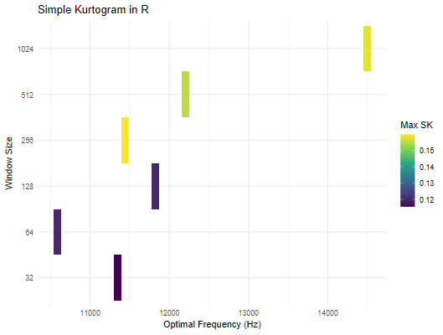
Appendix A: STFT parameters
Window size of 256 gives the maximum spectral kurtosis value somewhere around the fault frequency
calgaryanalyticsltd.com

Slide 14
Appendix A: STFT parameters
The kurtogram on the previous page is based on vibration signals from day 20. (I considered the first 20 days as “training” data). It leads to a window size of 256 for STFT.
The MATLAB tutorial uses a window size of 128, but it is not clear from their tutorial which day did they consider. For day 50, a window size of 128 yields the maximum spectral kurtosis. But if we start our predictions of RUL on day 20, we don’t have access to the vibration data on day 50. Hence, I stuck to the window size recommended by the kurtogram on day 20.
calgaryanalyticsltd.com

Slide 15
Appendix B: Exponential Degradation
MATLAB has an inbuilt package for exponential degradation modeling based on the work by Gebraeel (2006) [4].
In the IEEE paper mentioned above, 25 bearings were tested and degradation information was recorded. This information served as the “informative prior” for the exponential degradation model for the remaining bearings.
Closed form analytical solution for the posterior distribution is available in the paper and can be very easily coded in R.
calgaryanalyticsltd.com

Slide 16
Appendix B: Exponential Degradation
The closed form solution is based on some crucial assumptions:
The prior distribution of the stochastic parameters in the exponential model have a bivariate normal distribution.
The error variance from the 25 “test” bearings are assumed to apply to the error variance for the remaining bearings.
Since no such information from test bearings are available in the current example, weakly informative priors were used in the analysis of the wind turbine bearings.
calgaryanalyticsltd.com

Slide 17
Appendix B: Exponential Degradation
In addition to assuming weakly informative priors, the tutorial on MATLAB also uses an educated guess for the error variance.
In my analysis, I used the error variance from the fitting of an exponential form to the first 20 days of data.
A complete analysis would require testing of such assumptions before model implementation.
calgaryanalyticsltd.com

Slide 18
Appendix B: Exponential Degradation
Additionally, the referenced paper uses the average amplitude of the defective frequency as the degradation signal. This allows an easy setting of the failure threshold according to industrial standard ISO 2372. Setting of this threshold is required to calculate RUL.
In contrast, the tutorial on MATLAB uses a “fused” health indicator. Setting a failure threshold for such an indicator can be tricky, especially without information from historical failures. To get around this, the threshold was set to the value of the health indicator on day 50.
calgaryanalyticsltd.com

Slide 19
Appendix B: Exponential Degradation
Obviously, one wouldn’t have values from day 50 from day 20 onwards, when we need to calculate the RUL. This is where historical failure information as well as SME information from vibration specialists could be useful.
I applied a similar method for the degradation signal I used (spectral kurtosis), with the knowledge that we can build an improved model with additional context specific information.
calgaryanalyticsltd.com

Slide 20
Appendix C: Potential Improvements
As mentioned in Appendix B, lack of historical data and context specific information meant that broad assumptions had to be made to fit the model.
Further improvements in the model performance could possibly be realized with:
Additional historical data. This will provide “informative priors” instead of the “weakly informative priors” currently used to estimate model parameters.
Fusing multiple vibration features into a single “health indicator” instead of using only one feature i.e. spectral kurtosis as the degradation signal. The MATLAB tutorial does this using Principal Components Analysis (PCA).
calgaryanalyticsltd.com

Slide 21
Appendix C: Potential Improvements
Current model assumes that vibration signals are collected every day under similar operating conditions, and the only source of variance is the degradation in the bearing. A model that incorporates varying operating conditions, like the one proposed by Gebraeel and Pan (2008) [3] could be attempted.
Contextual information from operations and maintenance teams can again help with “informative priors” for the Bayesian model.
calgaryanalyticsltd.com

Slide 22
Appendix C: Potential Improvements
Subject matter expertise from vibration specialists can help in better extraction of information from vibration signals. (Window size for STFT, number of FFT points etc.) and an informed setting of the failure threshold.
The current model, albeit simple, is a good starting point and provides a good foundation on which additional complexity can be incorporated.
calgaryanalyticsltd.com

Slide 23
References
[1] Saidi, L., Ben Ali, J., Bechhoefer, E., & Benbouzid, M. (2017). Wind turbine high-speed shaft bearings health prognosis through a spectral Kurtosis-derived indices and SVR. Applied Acoustics, 120, 1-8.
[2] MathWorks. (n.d.). Wind Turbine High-Speed Bearing Prognosis. Retrieved September 6, 2025, from https://www.mathworks.com/help/predmaint/ug/wind-turbine-high-speed-bearing-prognosis.html
[3] Gebraeel, N., & Pan, J. (2008). Prognostic Degradation Models for Computing and Updating Residual Life Distributions in a Time-Varying Environment. IEEE Transactions on Reliability, 57(4), 539–550.
calgaryanalyticsltd.com

Slide 24
References
[4] Gebraeel, N. (2006). Sensory-Updated Residual Life Distributions for Components With Exponential Degradation Patterns. IEEE Transactions on Automation Science and Engineering, 3(4), 382–393.
calgaryanalyticsltd.com

Slide 25
End
calgaryanalyticsltd.com

